Slide 1



Our Multi-Agent System: The Secret Recipe? Pasta, Patate and Provola
Alessio Attolico, Gaetano D’Elia, Andrea Roscini

Slide 2

PROJECT OVERVIEW
Main Goal: Automate data analysis and visualization through a multi-agent system.
Key Features:
Conversational interactions for data analysis.
Efficient task routing through modular agents.

Slide 3
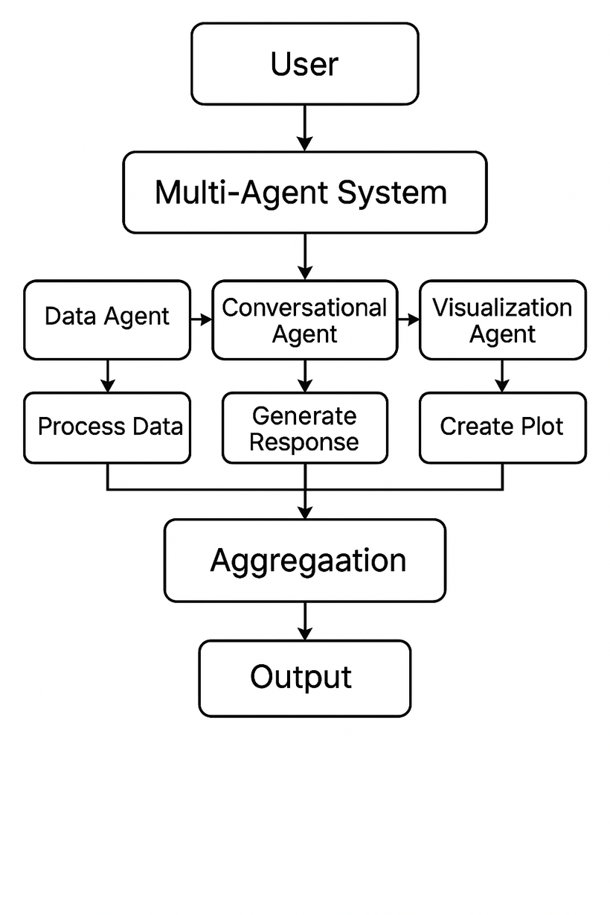
SYSTEM ARCHITECTURE
Framework: Built using swarms for modularity and coordination.
Main Components:
Conversation Agent: Routes tasks based on user input.
Data Processing Agent: Handles data analysis using pandas.
Visualization Agent: Generates plots using seaborn and matplotlib.
Task Routing: Managed through ClusterFlow for efficient delegation.
workflow of the multia-gent system

Slide 4

METHODS AND IMPLEMENTATION
Language Model
Data Analysis
Use Geminai with API key for robust NLP, leveraging the capabilities of Gemini 2.0-flash-001
Use pandas for data manipulation.
Data Handling
Visualization
Reads and processes four datasets: Access, Salary, Commute, Admins, that are the dataset given by REPLY
Plots generated using seaborn and matplotlib.

Slide 5
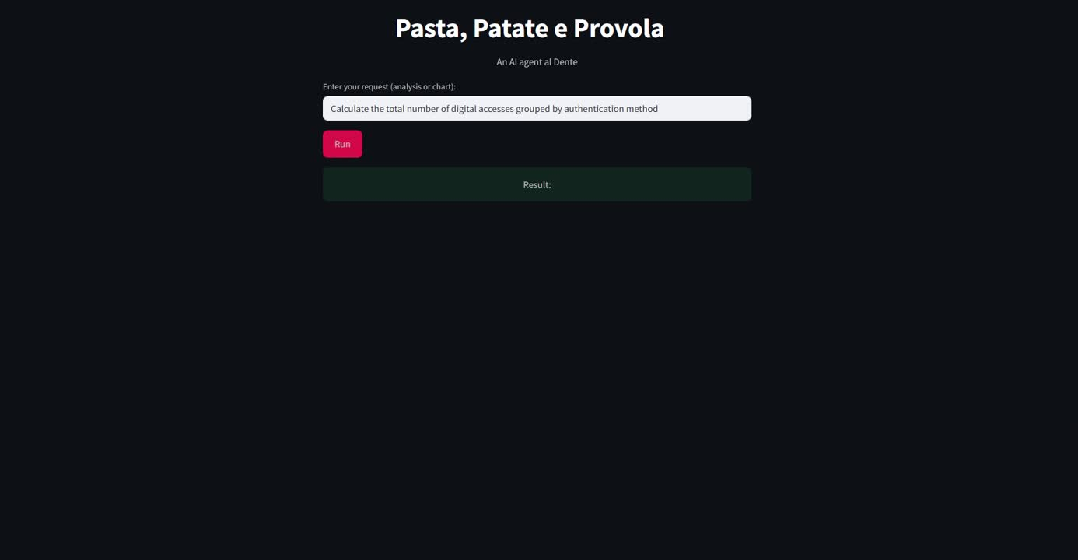
DEMONSTRATION OF THE MULTI-AGENT SYSTEM IN ACTION

Slide 6
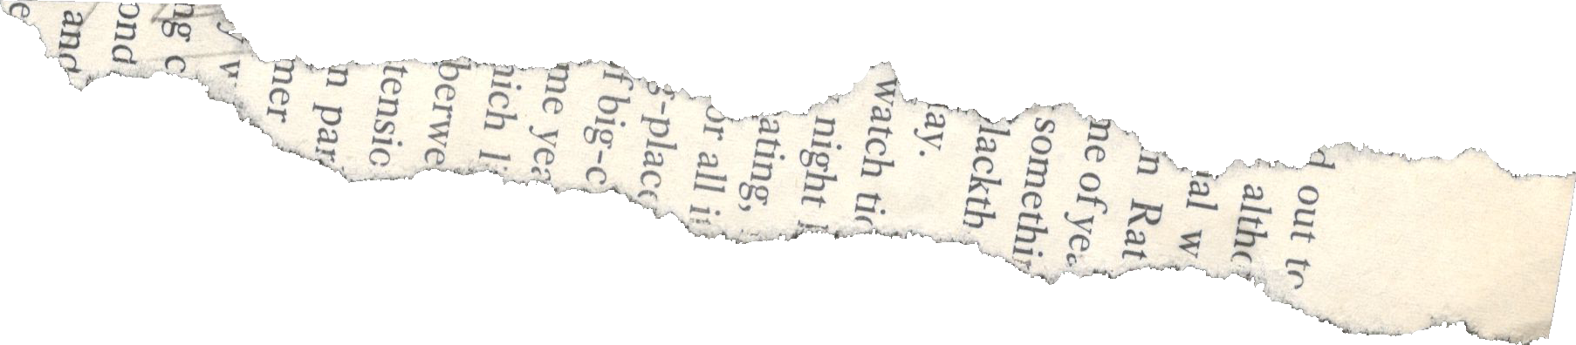
The multi-agent system we developed demonstrates the effectiveness of using modular agents to handle complex data processing and visualization tasks. By leveraging advanced natural language processing capabilities and efficient task routing, the system offers a flexible and robust solution for automating data analysis. Despite some challenges related to interpreting ambiguous natural language inputs, the system's ability to generate insightful visualizations and interact conversationally represents a significant step forward in data-driven decision-making.
CONCLUSION & IMPROVEMENTS

Slide 7


THANK
YOU !

